Slide 1

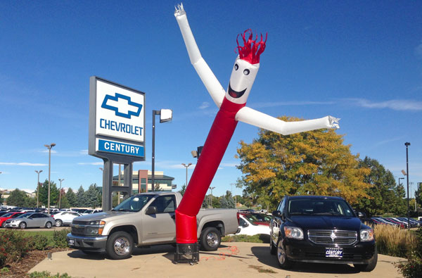
Maximizing Sales of Used Cars
An Anthony Tan Presentation

Slide 2
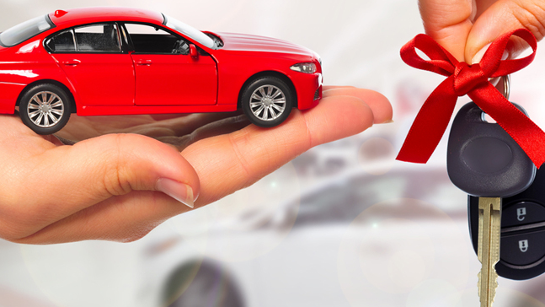
Objective
How can we maximize sales and revenue for second-hand vehicles?

Slide 3
Summary
Process
Findings
Set contains approx. 2500 vehicles
Data
Features for analysis include year, mileage, and brand
Extract relevant variables
Evaluate which variable has most impact on price
Mileage has most effect on price
Possibly underselling high mileage vehicles

Slide 4


Process

Slide 5
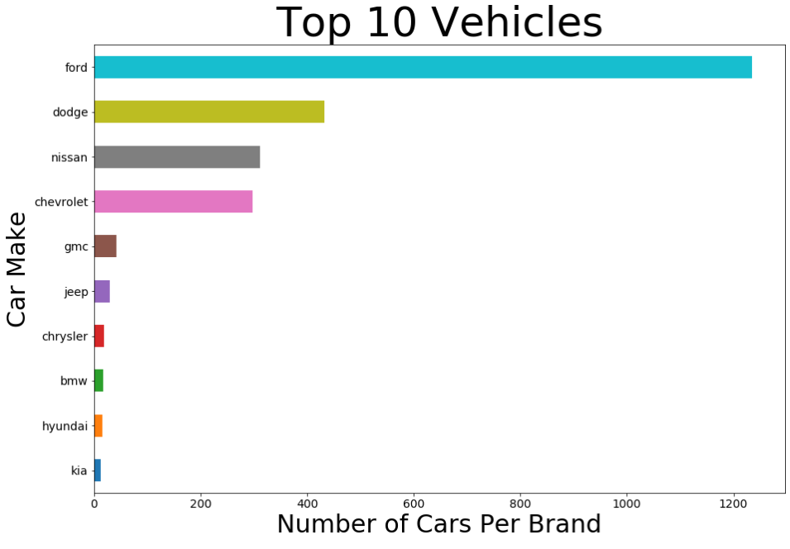
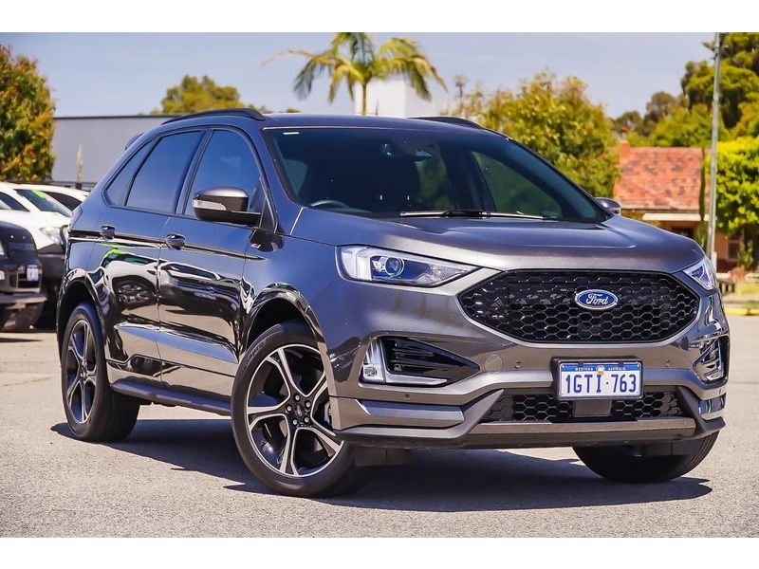
Top 10 Vehicles
First four makes up over 90% of all vehicles
Target marketing for Top 4 brands

Slide 6
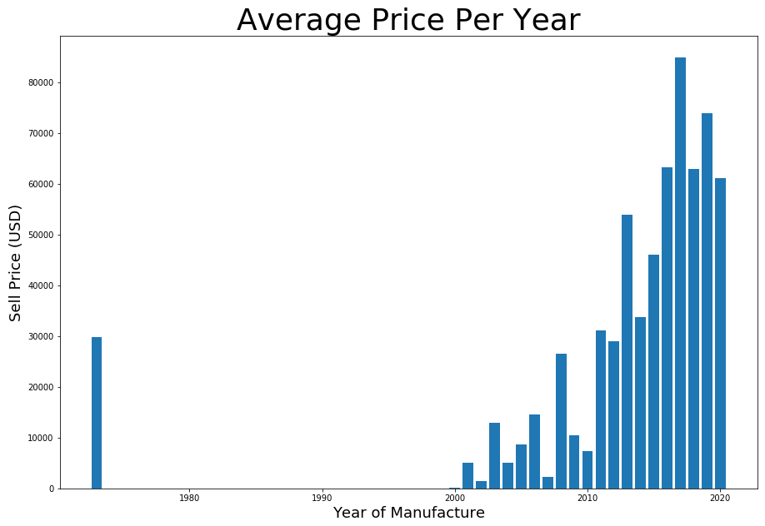
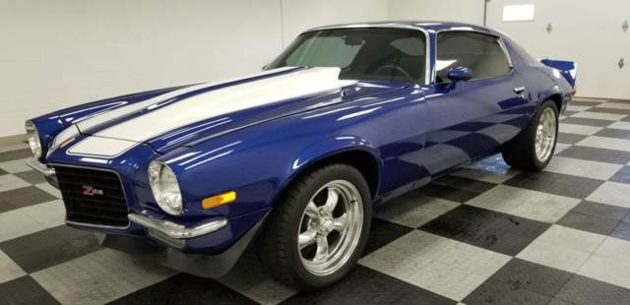
Year of Manufacture
75% are new models built after 2016.

Slide 7
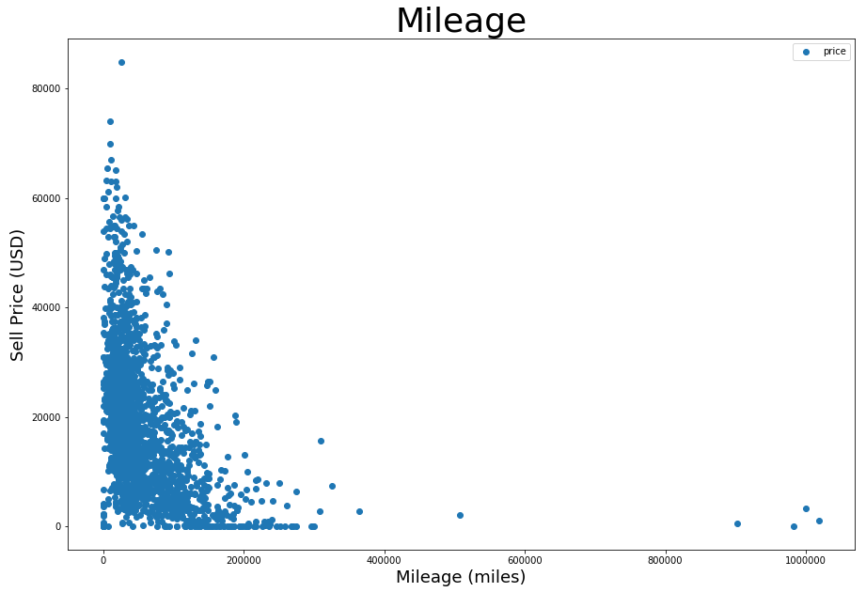
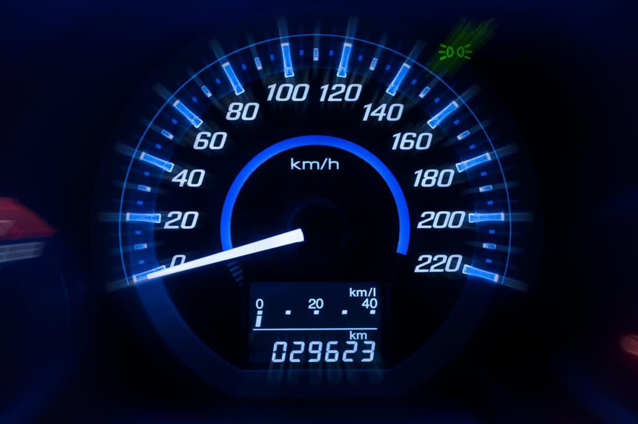
Mileage
Mileage has greatest impact on price

Slide 8
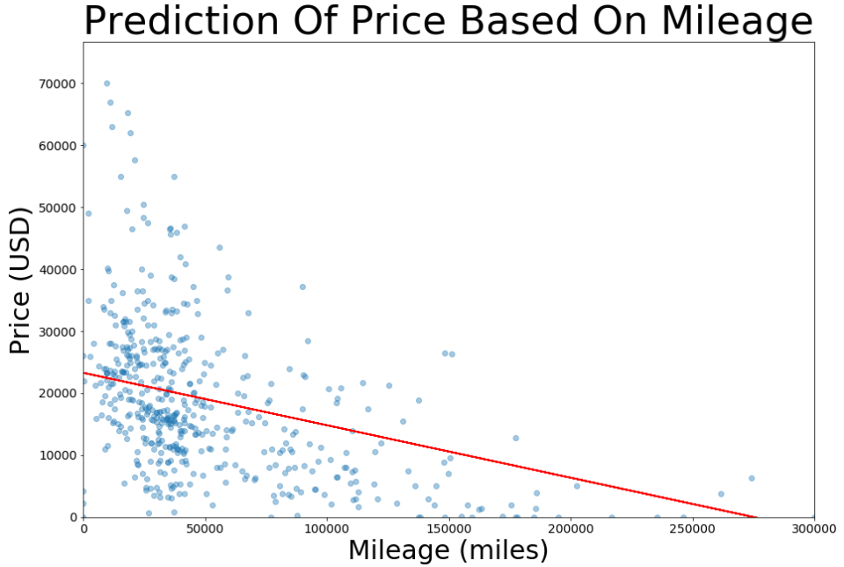

Predictions
Possibly underselling vehicles with high mileage

Slide 9
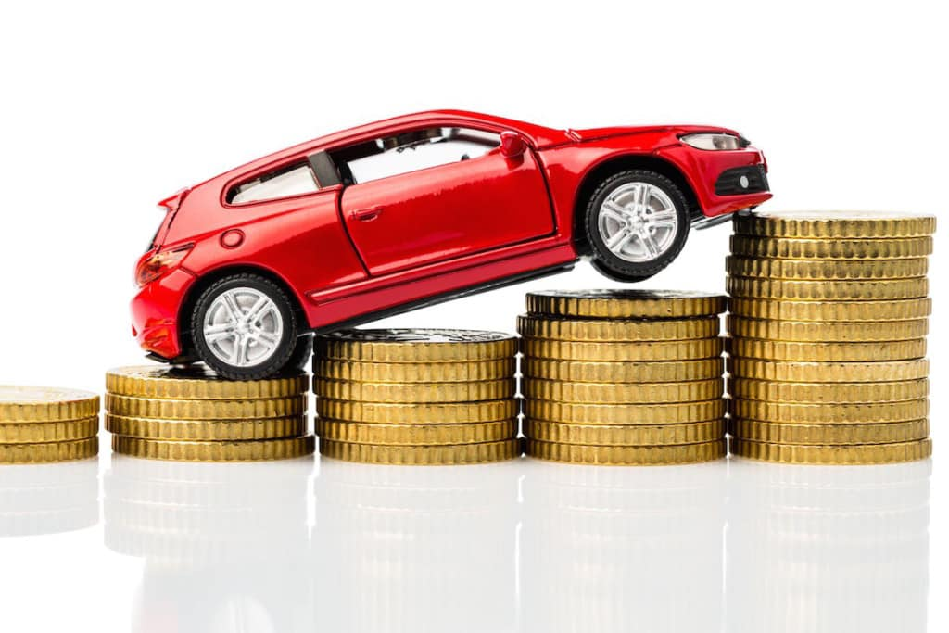
Recommendations
Sell higher price for higher mileage cars
Include following data for further analysis:
Purchase price
Purchase date
Number of days unsold
Number of previous owners
Targeted advertising to increase sales for top brands

Slide 10
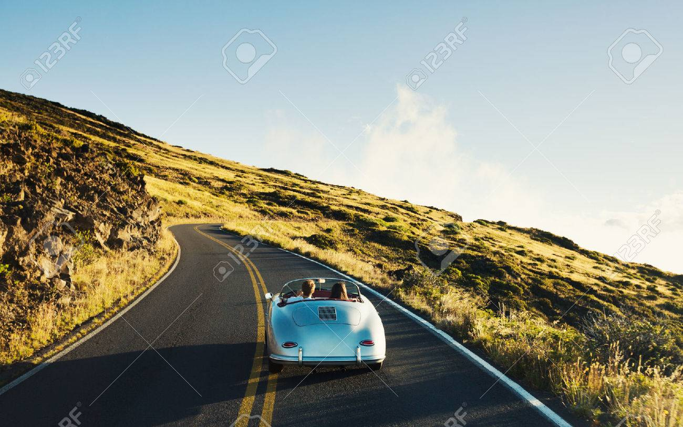
The End

Slide 11
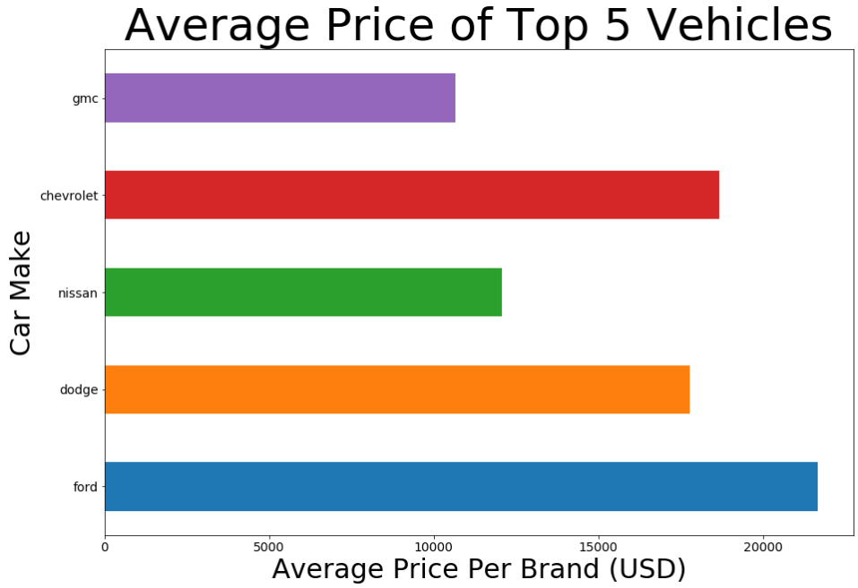
Top 5 Vehicles
Top 5 makes up over 92% of the total
Target marketing of these brands to maximize sales

